Slide 1
R and Rstudio tutorial
Ramsy Agha
Feb 2020
Disease Eco-Evo Lab

Slide 2
Timetable
Day
Thu 6.2.20 | 9h | Intro to R and Rstudio (Lecture w/ exercises)
 | 10.30h | Data import and quality check (Exercise)
 |  | Lunch break
 | 13h | Data manipulation (Exercise)
 | 14h | Visualization with ggplot2 (Guided tutorial)
 | 15.30 – 17.30 | ggplot2 challenge
Fri 14.2.20 (Florent) |  | Statistical analyses using R
 |  | Open lab (work with your data)

Slide 3
Good Practice during this tutorial
PowerPoint interspersed with Challenges and Cats
Try things out
Ask lots of questions
Help your neighbor
Take breaks if needed
Cheat!

Slide 4
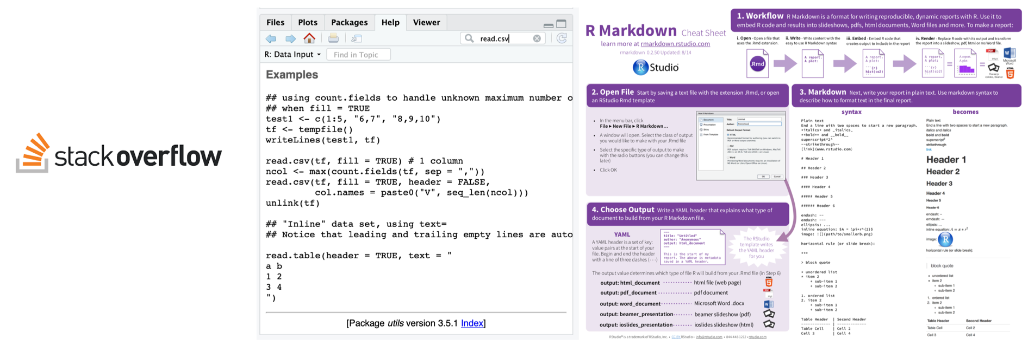
Cheating is allowed
Stackoverflow
?function() (takes you to documentation pages)
cheatsheets (see folder in the course repository!)

Slide 5


Watching vs. Doing
Listen when you see this cat
Do when you see this cat

Slide 6
All materials are available
https://github.com/ramsyagha/tutorials

Slide 7

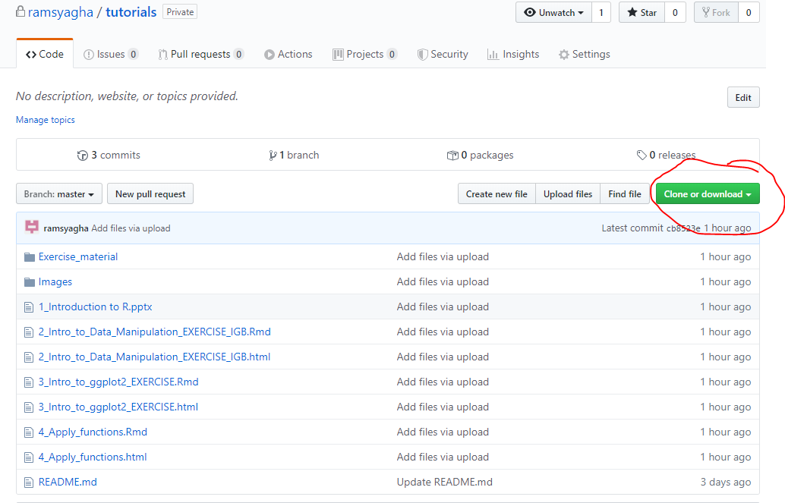
All materials are available
https://github.com/ramsyagha/tutorials
Remember the PATH where you download the zip file:
This will be your working directory in RStudio!
If haven´t already,
Pls do this now!

Slide 8
Introduction to R
Ramsy Agha
Feb 2020
Disease Eco-Evo Lab

Slide 9
R and RStudio
- R: free software environment for statistical computing and graphics
- RStudio: integrated development environment (IDE) for R

Slide 10
Why R?
powerful, flexible/customizable
easy for sharing and developing
reproducible science: scripts and markdowns

Slide 11
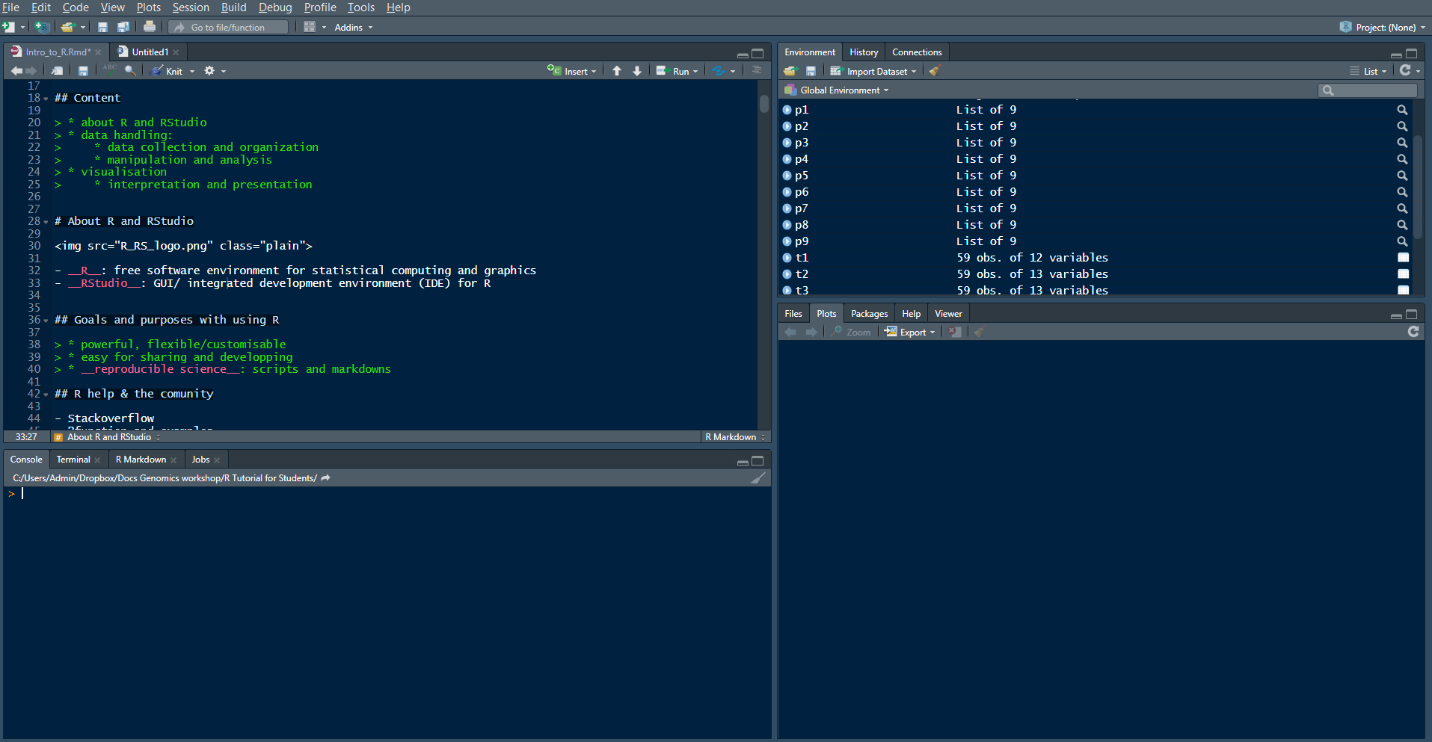
What is RStudio
SOURCE (Your notepad for code)
This is where you write your code
Your code will not be evaluated until you run it
(use „run“ button or Ctrl+Enter to run individual lines of code
3. ENVIRONMENT / HISTORY
Here you can see what objects are loaded into your working space and see your command history
4. FILES/PLOTS/PACKAGES/HELP
Here you can see file, directories, packages and help documentation (R help).
2. CONSOLE (R´s heart)
This is where your code from the source will be evaluated by R
You can also perform quick calculations that you dont need to save

Slide 12
Random tip! Are You Typing too much, You’re Doing Something Wrong!
Tab complete is a nice trick to save you typing, functions, dataset names, variables etc. that have been defined in the R environment will be autocompleted.
Get used to it and use it always, it will make you faster and you will avoid typos!

Slide 13
Error messages
Warnings should be acknowledged but can be ignored.
Specific hint? e.g.
wrong data format, characters/factors instead of numbers
library not loaded, package not installed
Google is your friend – cheating is allowed

Slide 14
Try it now
Type in your console (and press enter):
12+13+14
(5+2)*2
12^2
These are Arithmetic operators (basic math): +, -, *, /, ^, …

Slide 15
Try it now
Assignment operator
Type the following in your console
x <- 12
y <- 13
z <- 14
Look at your environment pane. What happened? Now type in your console:
x+y+z
This is an assignment operator <- You define R-objects with it

Slide 16
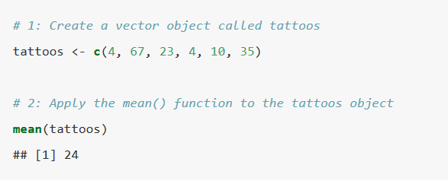
Objects and functions
R is all about 2 things: Objects and Functions
I will define an object called tattoos using the function c() and then compute it mean using the function mean()

Slide 17
Functions
function (object, arguments)
You can always type ?function() is your console to get information about what the function does and which aeguments it accepts
Try typing in your console:
?str()

Slide 18

Try it now
Create a vector object called k consisting of the numbers 12, 13 and 14.
Compute the sum of the vector k using the function sum()

Slide 19
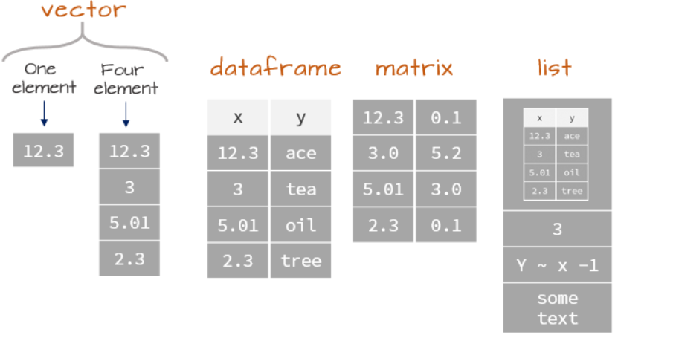
Data structures in R: Object types
What type of object did you just create?

Slide 20

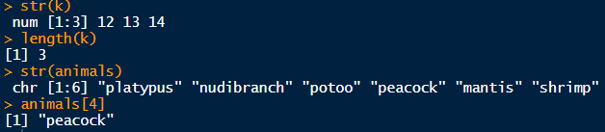
Inspecting objects
Lets create another vector called animals on top of the vector k we created earlier
Lets inspect them.
What do you see? What are we doing with this?
Remember str() you will use it a lot!

Slide 21


Modifying vectors
Lets modify those vectors. Try this code chunks and think about R is doing
Remember the [] can be used to refer to elements of an object. The referal can be a coordinate (e.g. first element k[1], or logical operations k[k<4]).
Can you figure out what´s going on?

Slide 22

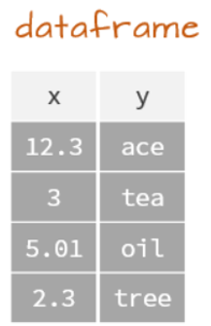

Data frames
Lets create some more compex objects
Inspect it
Modify it

Slide 23
Data frames
Selecting data within a data frame is similar as we saw with vectors. We use [] as well, but now we have 2 coordinates.
dataframe[row, column] to select rows and columns of a dataframe
(omission of any of the coordinates means select all)

Slide 24

Data frames
Create the following dataset (called „data“) typing this code:
Visualize to understand what we just created

Slide 25
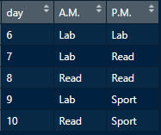
Data frames
Challenge: What do these commands do?

Slide 26
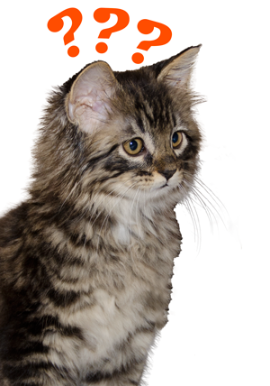
Questions?

Slide 27
Data collecting quality check

Slide 28
Data handling: collecting and organizating
Conventions about data format
Observations are entered in rows
Variables are entered in columns
A column of data should contain only one data type

Slide 29
Data handling: collecting and organization
Best practice
Store a copy of data in nonproprietary formats
Leave an uncorrected file when doing analyses
Create folders for relevant task to keep the overview over your analyses

Slide 30
Data handling: Tutorial
Open tutorial file:
./Tutorials/ 1_Intro_to_Data_Manipulation_EXERCISE.html
Rules for this tutorial: Run all the code on your laptop
NO COPY PASTING ALLOWED

Slide 31
Data handling: Practice time!
Tutorial file:
1_Intro_to_Data_Manipulation_EXERCISE.html

